Slide 1



Confidence interval

Slide 2
What is statistical influence?
To draw conclusion of entire population based on sample data.

Slide 3
Statistical inference
Estimation
Hypothesis testing

Slide 4
Estimation
Point estimate :- It’s a number that is a best guess for population parameter.
Interval estimate:- Range of value which we expect the parameter to fall.

Slide 5


Slide 6
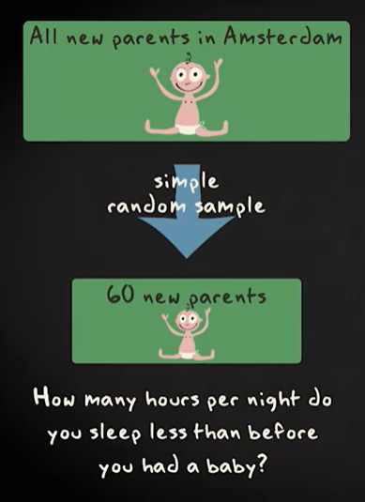

Slide 7
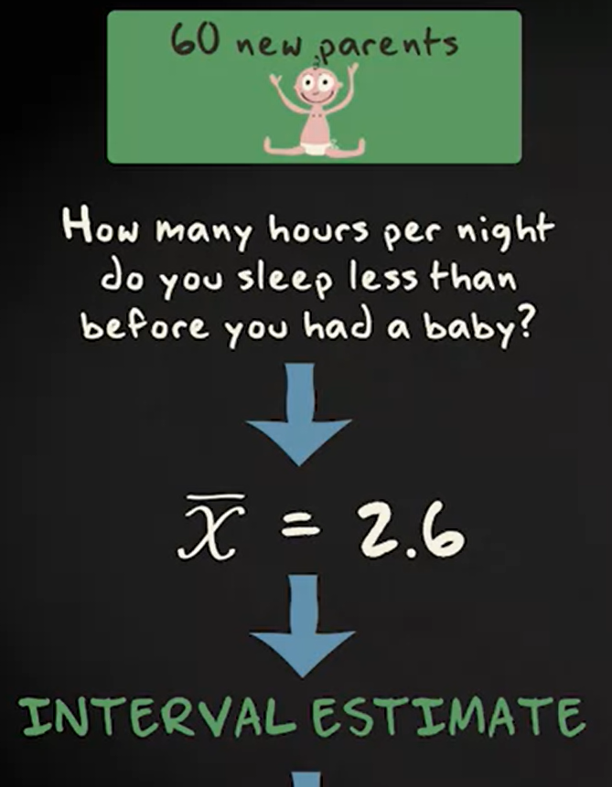




Slide 8
Confidence interval
Probability that interval contains population value is confidence interval.
We almost consider for 0.95 cases that is 95% confidence interval.

Slide 9


CI for mean with known population sd

Slide 10
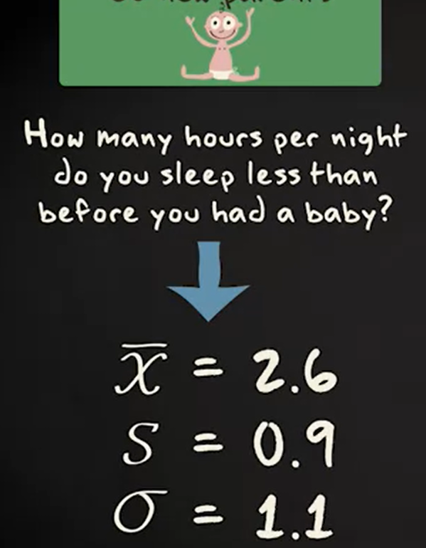

Slide 11
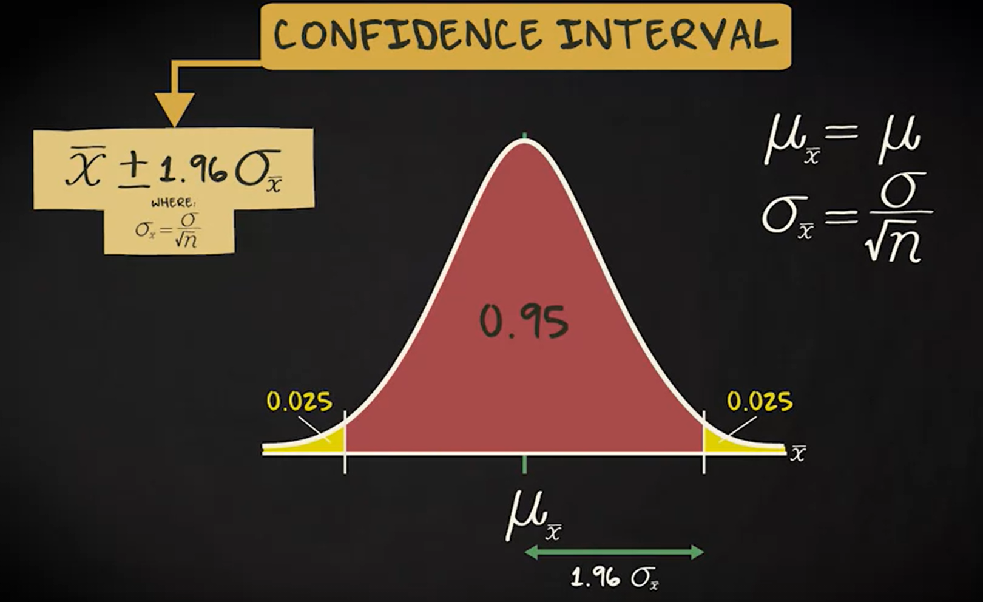

Slide 12
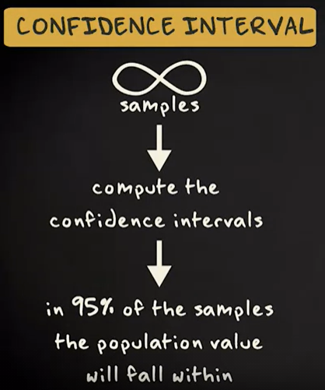
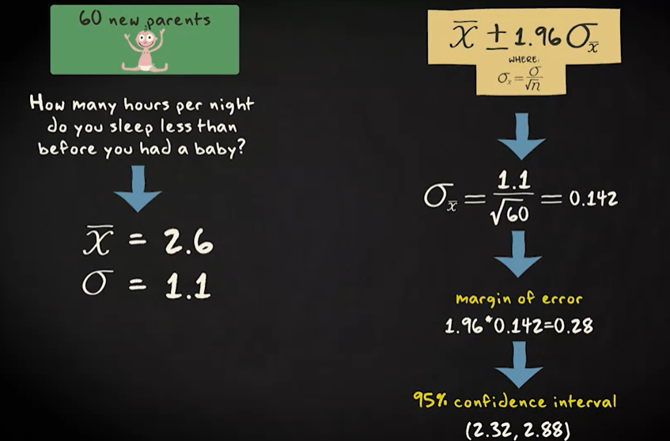

Slide 13



Slide 14
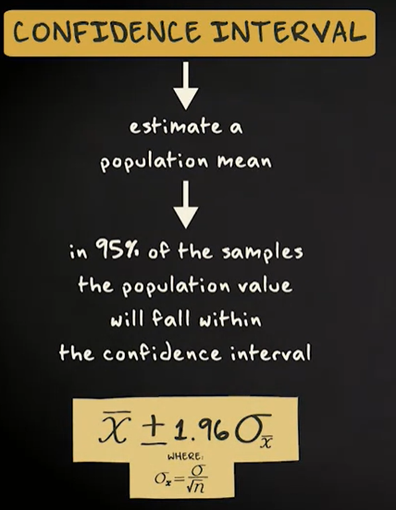
CI for mean with unknown population

Slide 15
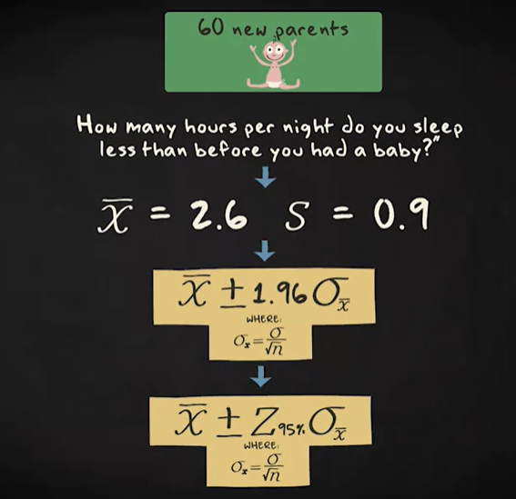
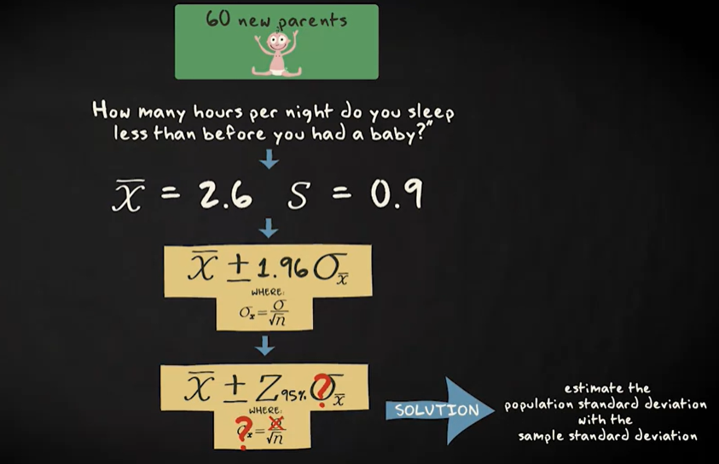
T-distribution

Slide 16
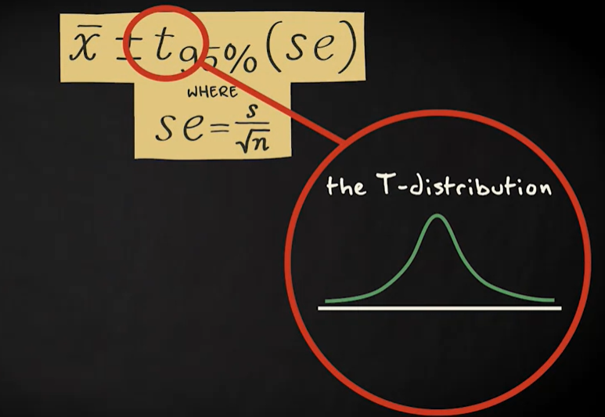
T - distribution

Slide 17
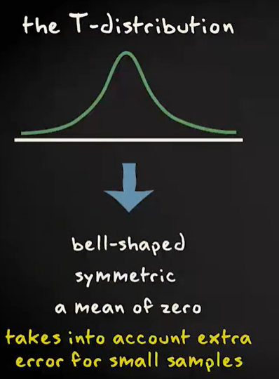
T-distribution

Slide 18
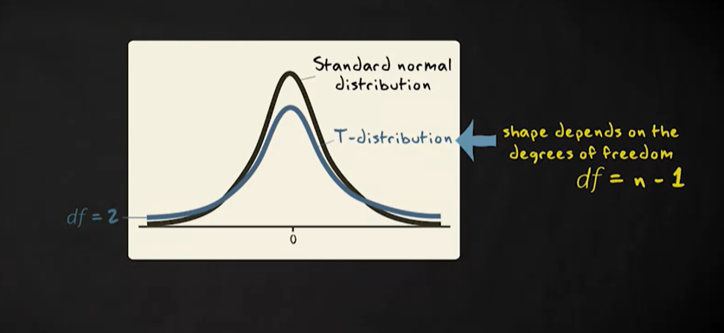
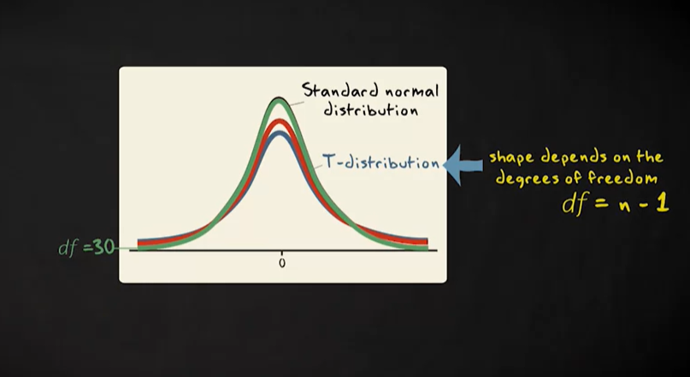
T-distribution

Slide 19
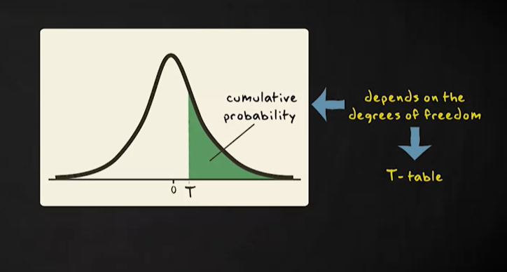
T- distribution

Slide 20
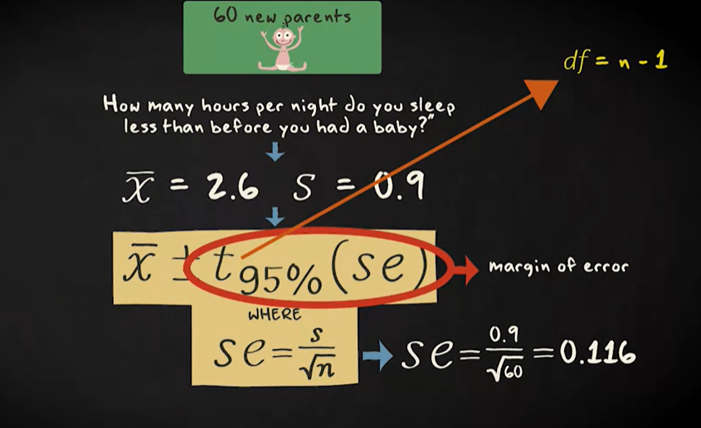
T - distribution

Slide 21
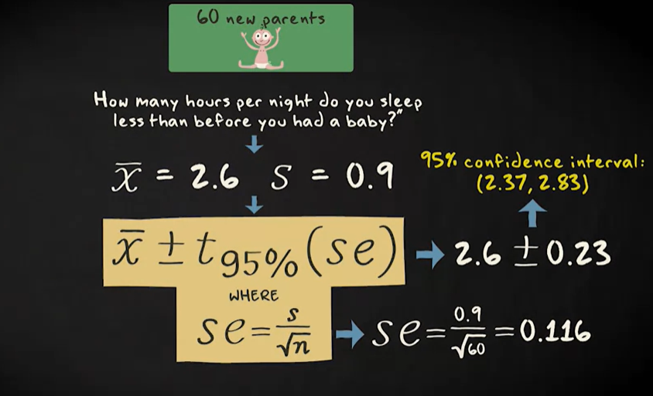
T- distribution

Slide 22
Assumption of Confidence interval
Randomization
Approximately normal population distribution ( t-distribution robust against violence)
Careful about extreme outliers.

Slide 23
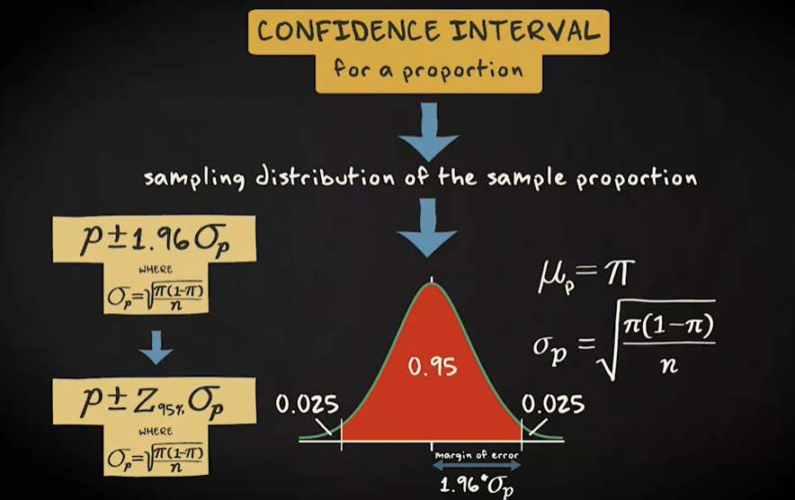
Confidence Interval for proportion

Slide 24
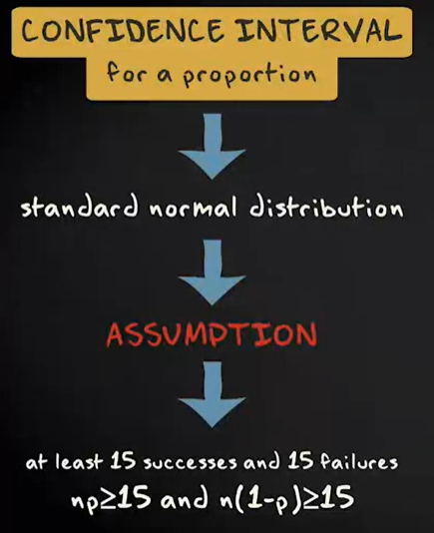
Confidence Interval for proportion

Slide 25
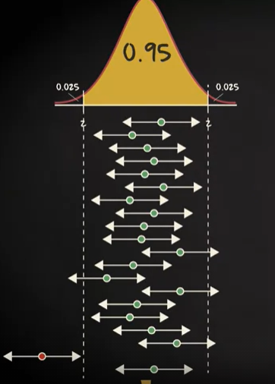
Confidence Interval Interpretation
If we draw an infinite number of sample like our actual sample, and for every sample we computer 95% of confidence interval with similar margin of error, 95% of the population value will falls with the confidence range.

Slide 26
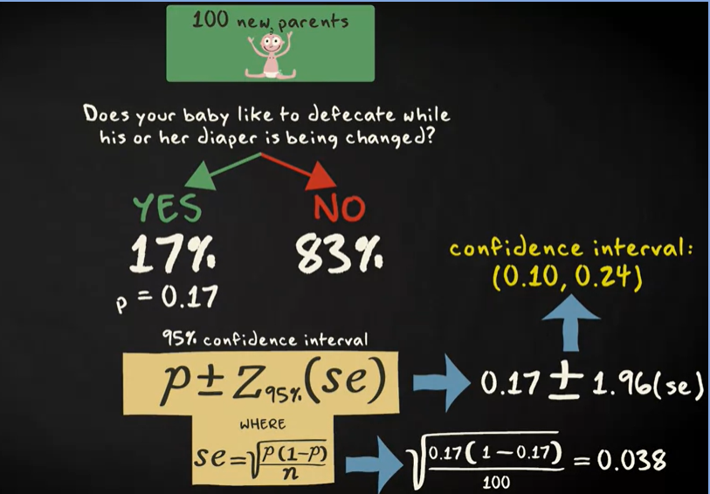
Choosing confidence level for 95%

Slide 27
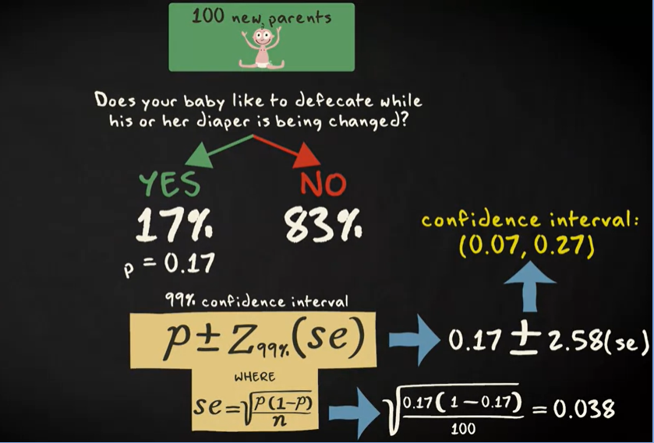
Choosing confidence level for 99%

Slide 28
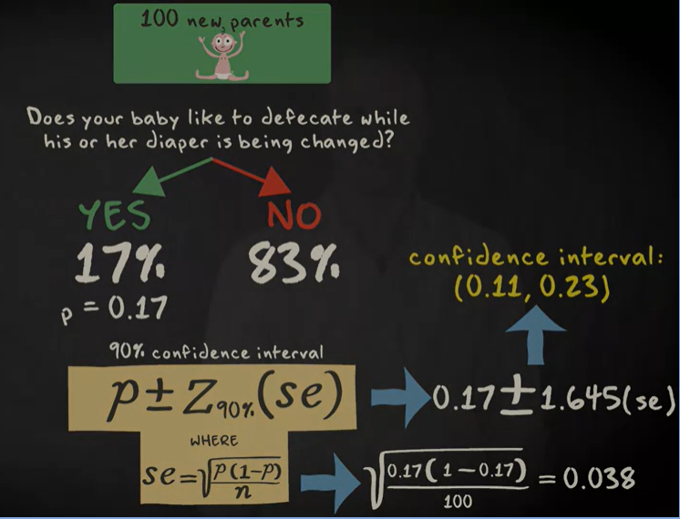
Choosing Confidence level at 90%

Slide 29
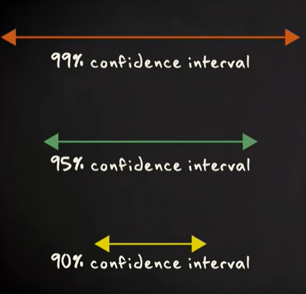
Interpretation of choosing confidence level
The more confident we are drawing the population the larger the margin of error.

Slide 30
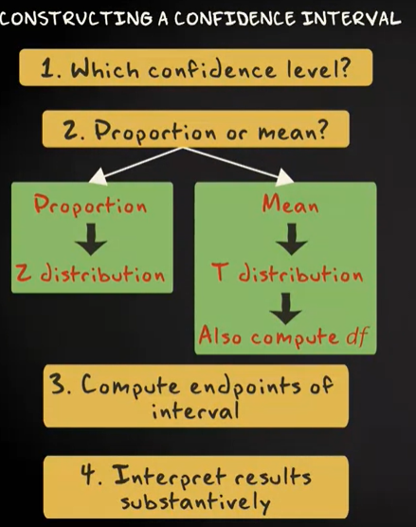
Constructing a Confidence interval

Slide 31

Choosing the sample size

Slide 32
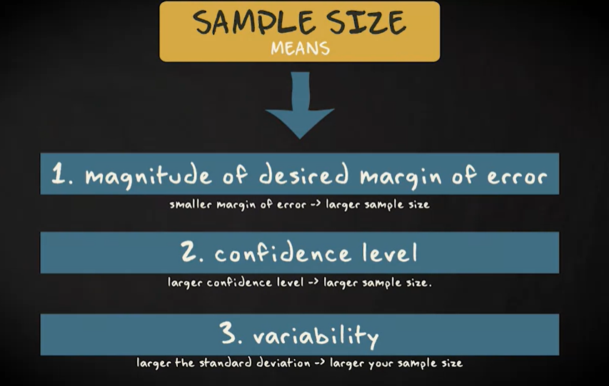
Choosing the sample size

Slide 33
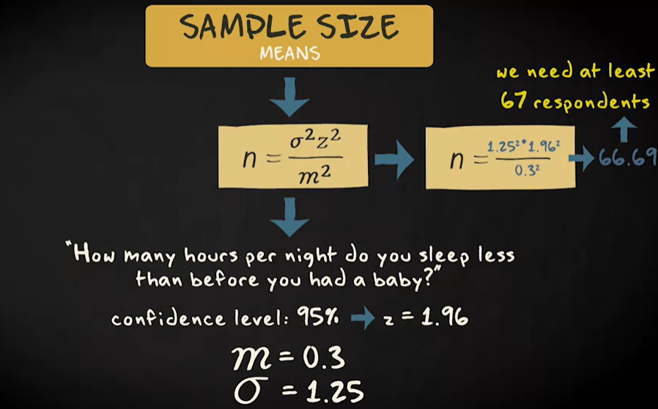
Choosing the sample size

Slide 34
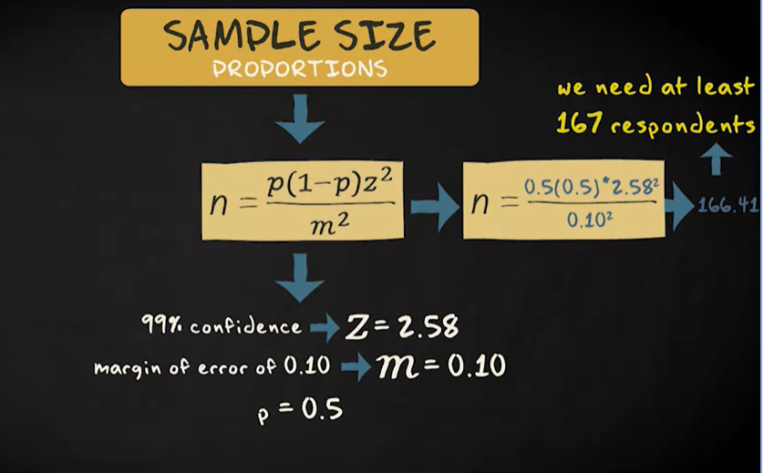
Choosing the sample size

Slide 35

Computing sample size

